Slide 1

Discovering DirectX: user-land internals of the Windows Vista graphic stacks
ESC 2023
Christian Rendina

Slide 2

whoami
Christian Rendina
Student
Self-taught developer and improvised reverse engineer
Low level, computer graphics and game dev enthusiast
(Inside joke with some friends)

Slide 3
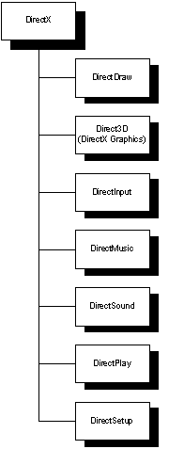
What is DirectX
A set of components to develop videogames
Direct3D is the component that talks to the GPU to perform 3D functionalities
The linux counterpart is either OpenGL or Vulkan
Source: informit.com

Slide 4
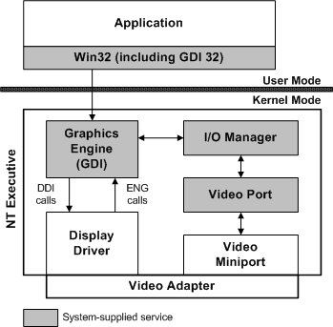
Windows XP Display architecture (XDDM)
Kernel-mode miniport driver
Kernel-mode display driver
Everything is connected via the Window subsystem (win32k.sys)
Accesed in user-mode via Win32k syscalls (GDI32.dll)
Display driver talks directly to the miniport via IOCTL
Source: MSDN

Slide 5
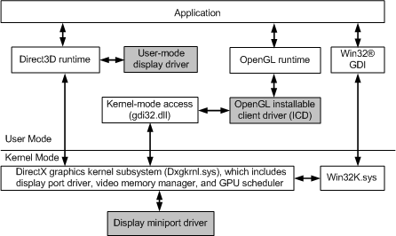
Windows Vista Display architecture (WDDM)
Kernel-mode miniport driver
User-mode display driver (UMD)
DirectX now runs inside the kernel (dxgkrnl.sys)
GDI is disconnected from the graphics subsystem
No more IOCTL or specific communication to the GPU
Source: MSDN

Slide 6
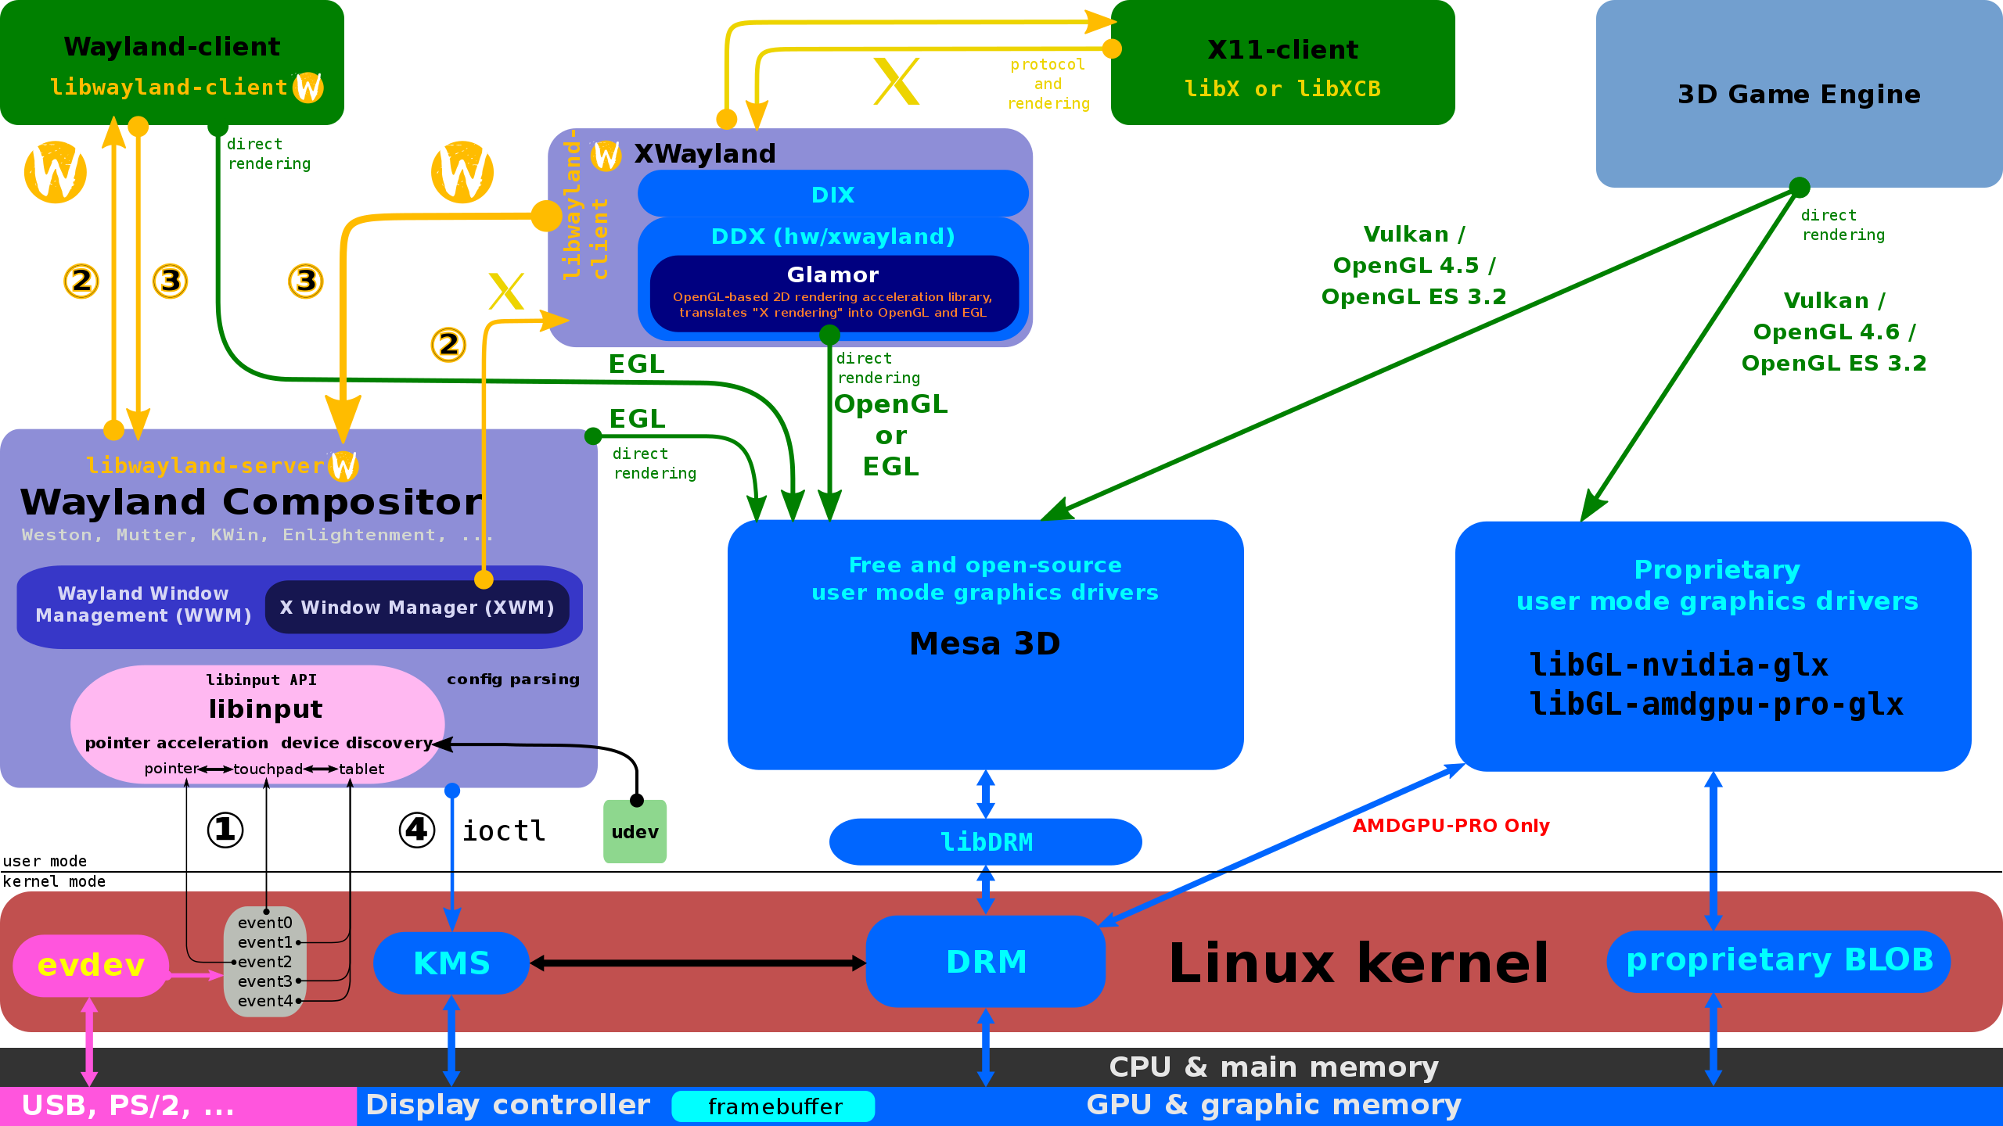
Linux Display architecture (for comparison)
The division between OpenGL runtime and the driver is internally done inside Mesa
Mesa runs in user-mode like the UMD with the d3d runtime
Different components of dxkgrnl are implemented inside DRM (KMS is part of it)
No graphic subsystem running in the kernel
Source: Wikimedia Commons

Slide 7
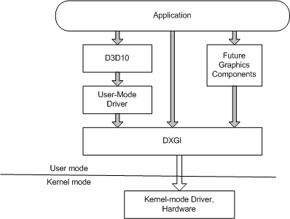
User-land components
Two main components exposed for the userland:
Direct3D Runtime
DirectX Graphics Infrastructure (DXGI)
Looks quite simple, right?
Source: MSDN

Slide 8
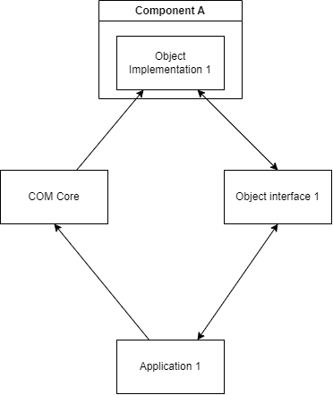
Cirno’s Perfect COM Class
Enables inter-process communication of different components
Each components doesn’t know their implementations but only an abstract interface
Each component implements reference counting
Every components has it’s own UUID which allows it to be easily identificable and buildable

Slide 9
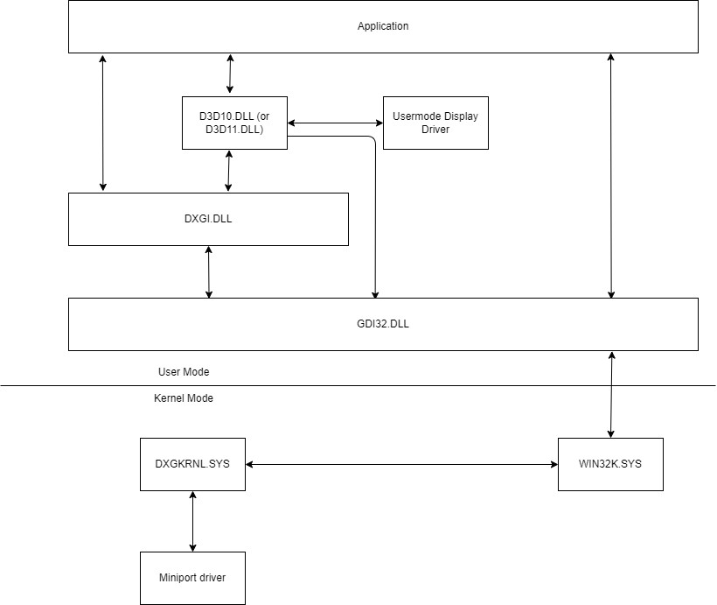
How DXGI and D3D really works
User-land diagram was mostly correct
D3D10 and DXGI talks through undocumented COM interfaces
Everything actually escapes back to GDI32 and WIN32K
WIN32K is glued with DXGKRNL for GDI acceleration

Slide 10
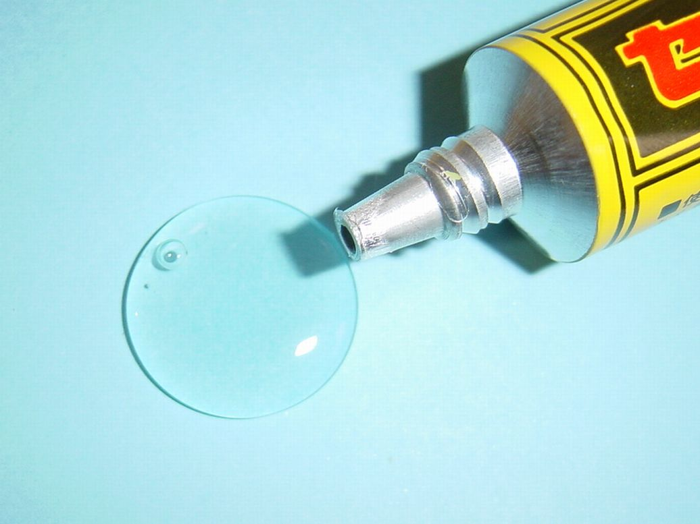
It’s all glued back to GDI
GDI32 exposes all the user-land functions
Each D3DKMT* (DXGKRNL exposed api) is implemented trough a syscall to WIN32K
WIN32K then forwards the function to DXGKRNL where the real operation happens
Source: Wikipedia

Slide 11
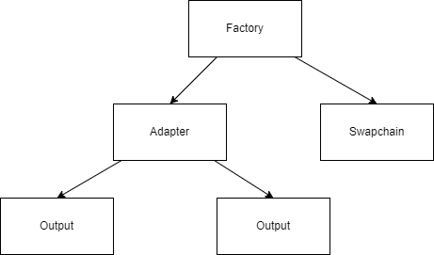
What is implemented inside DXGI?
A factory to create all the other classes
Rapresentations of GPU Adapters
Rapresentations of Monitors
A swapchain
Base objects for everything DirectX related
Internal structures

Slide 12
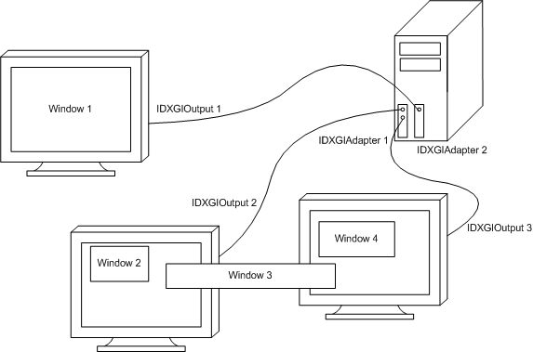
GPUs and Monitors
A system can have one or more GPUs (rapresented as adapters)
A GPU can have attached none, one or more monitors
Remote GPUs are also supported
Source: MSDN

Slide 13
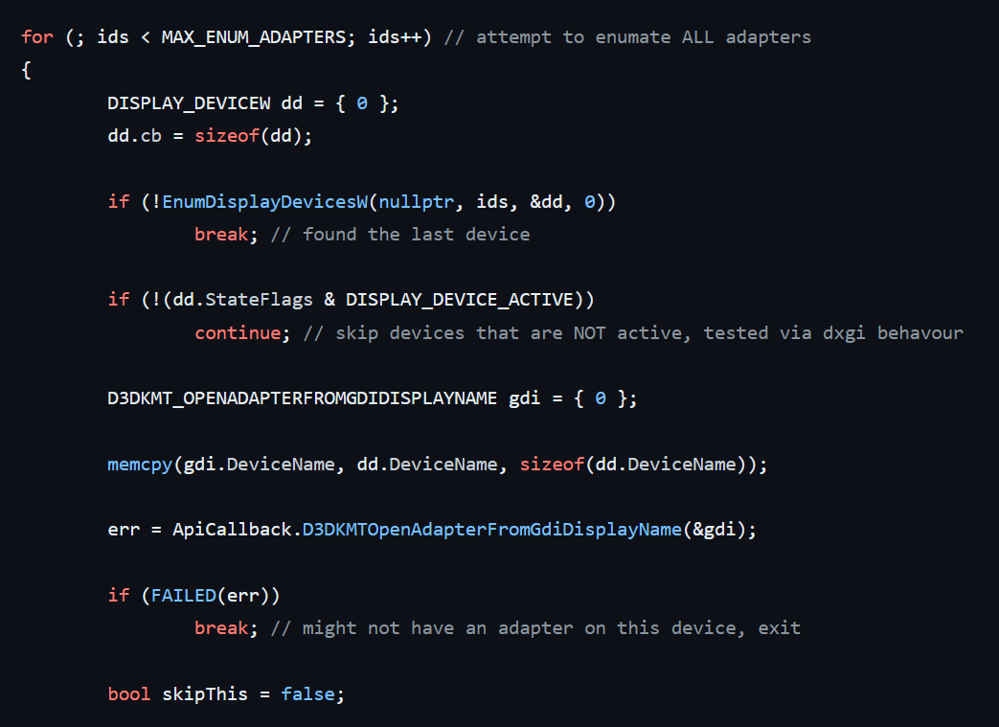
Example enumeration to adapters

Slide 14
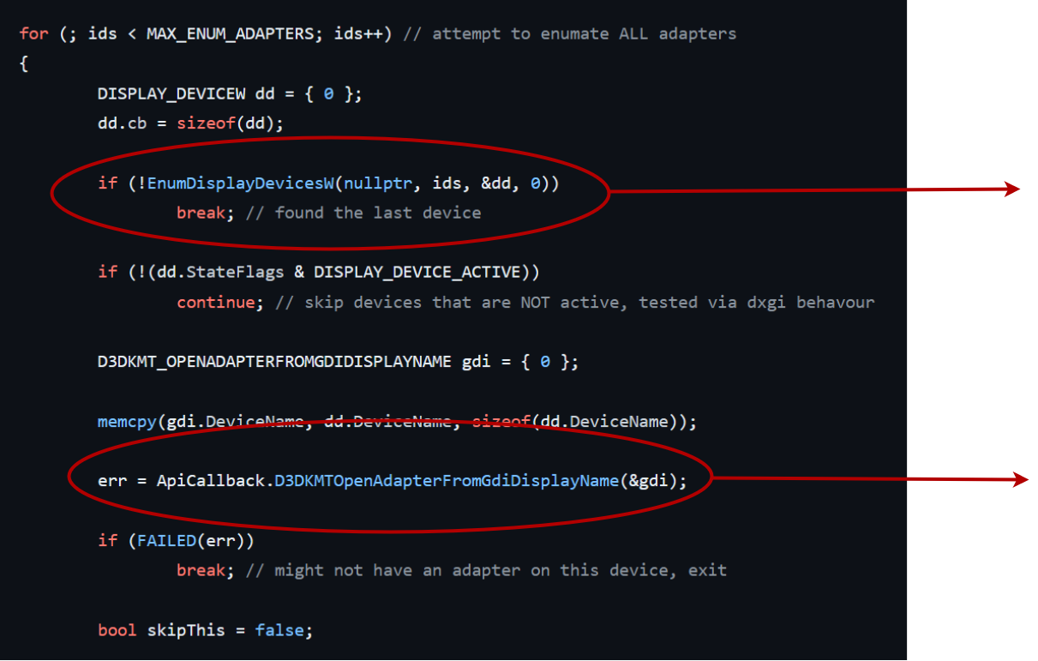
Did Microsoft lie to us?
GDI32 calls
Adapter access from GDI name

Slide 15
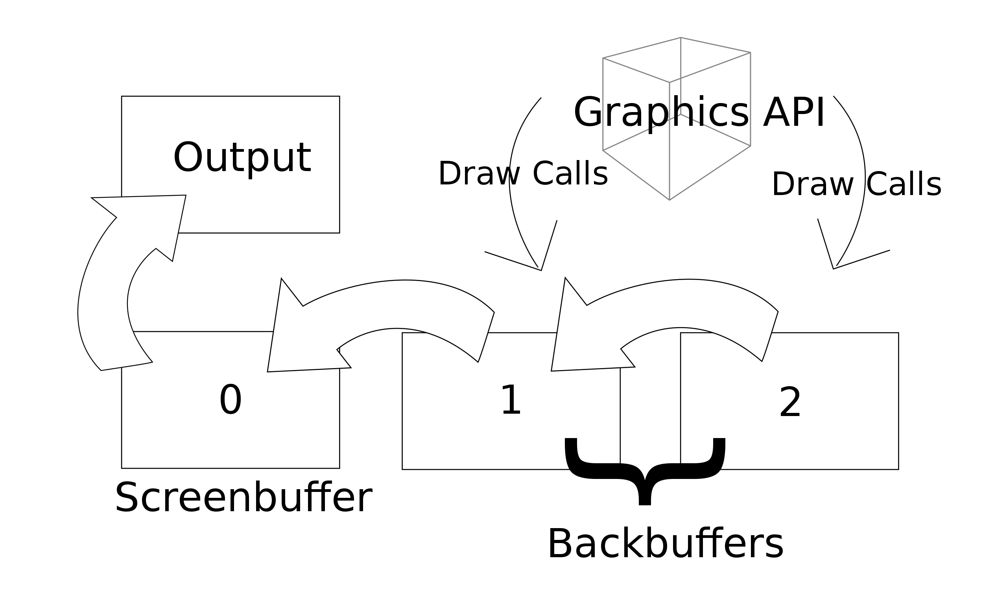
What’s a swapchain
A component that holds multiple «screens» into memory
It’s main responsability is to swap them to the screen
Avoids tearing and similar issue
Source: MSDN

Slide 16
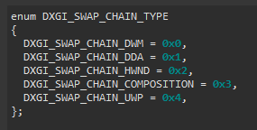
Types of swapchains
Fullscreen Swapchain (DWM)
DDA Swapchain
Windowed Swapchain
DirectComposition (Partner) Swapchain
UWP (XAML) Swapchain
Probably more undiscovered?

Slide 17
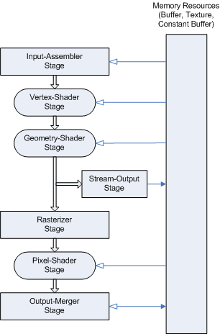
What’s implemented in D3D10
A device to render resources to the GPU
Connections to the UMD
Every resources used in game (such as texture or vertex buffers)
Presenting changes to the screen
Shader compilation and submit to the GPU
Source: MSDN

Slide 18
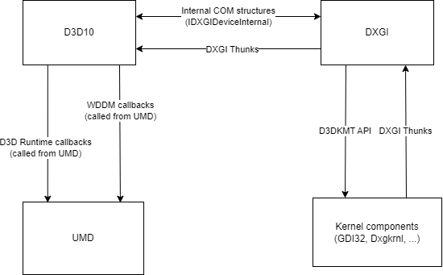
How D3D10 talks to DXGI and UMD
DXGI Thunks are exchanged from kernel to the runtime to bypass DXGI
Internal COM structures to talk to DXGI
The exchange between the UMD is just a bunch of callbacks

Slide 19
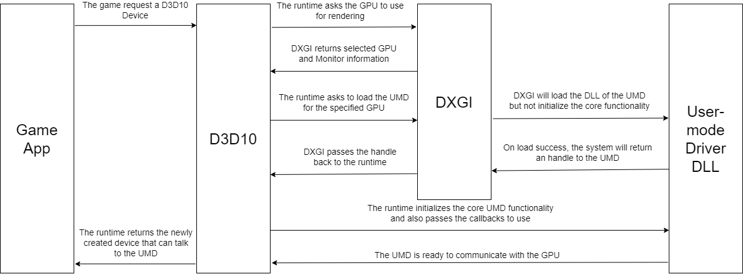
Who is responsable for the UMD?

Slide 20
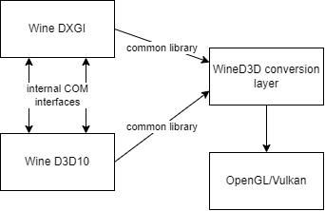
Want some Wine?
As expected, Wine doesn’t talk to any kernel
Everything is translated back to OpenGL or Vulkan
Internally D3D10 and DXGI communicates between each other via COM
Interoperability unlocked?

Slide 21
Live demo
Proof of concept of a custom made DXGI
Running under Windows 7 SP1 DirectX runtime (D3D11 with Windows 8 updates)

Slide 22
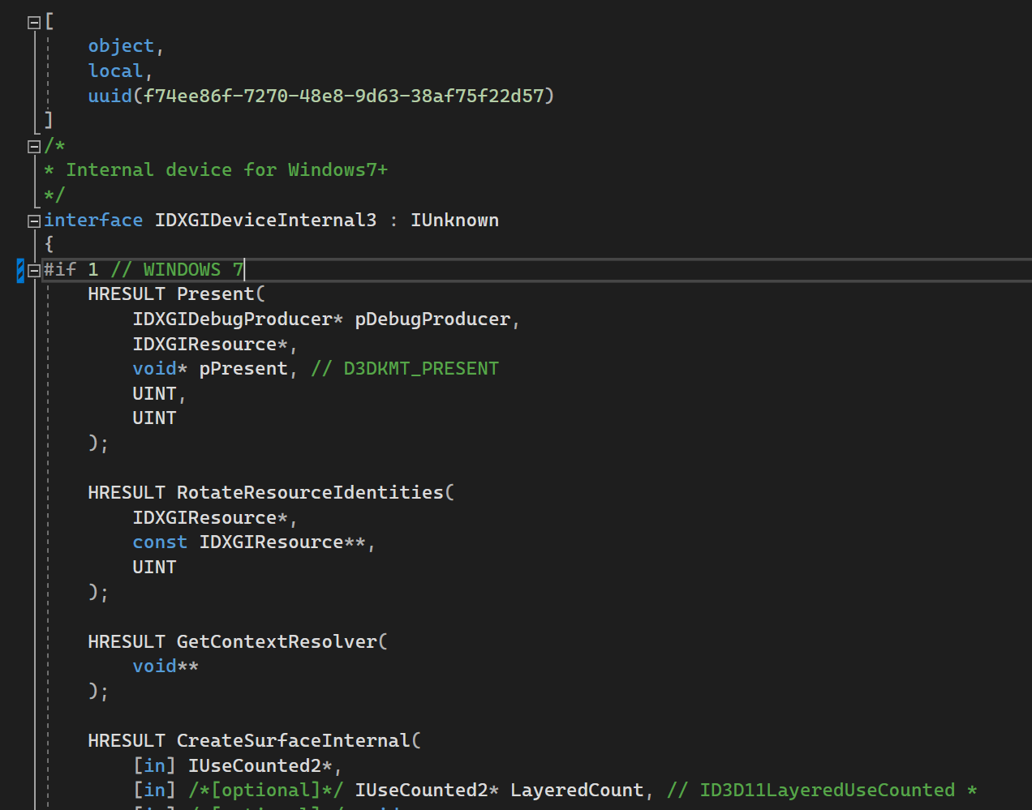
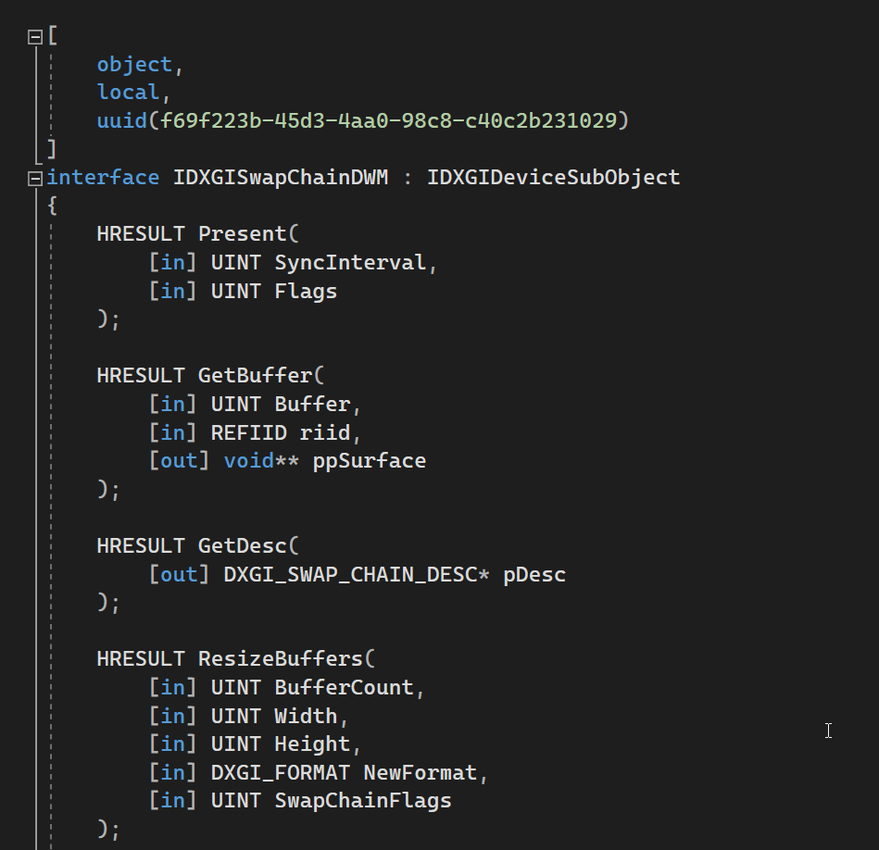
Is it really everything?
More than 20 undocumented APIs on DXGI alone
Undocumented APIs for DWM, XAML and DirectComposition
Something more in the future?

Slide 23

Thank you for your attention!
Special thanks to ESC for inviting me to do this talk
Special thanks to the people at ReactOS Longhorn for help and support on the kernel part
https://github.com/lakor64/pff/

